Slide 1
Executive Matching Ranker Baseline Model
Daniel Godden
July 2023

Slide 2
What are we trying to solve?
Identify which senior executives to recommend for deal opportunities.
Explore ways to improve this solution.
We want to a way to automate the improvement of this solution.

Slide 3
Data Processing & Feature Engineering | 4-6
Model Training - LightGBM | 7-9
Results and Evaluation | 10-12
Automating Solution | 13-16
Next Steps | 17-20

Slide 4
Data Processing & Feature Engineering

Slide 5
Data Processing & Feature Engineering
Data Loading
Load three CSV datasets:
exec_roles.csv – Executive metadata (ID, attribute type, value)
match.csv – Historical matches between executives and assignments, with binary outcomes
opp.csv – Opportunity metadata (industry, sectors, sub-sectors, scale, country)
Standardise ID fields (assignment_id, exec_entity_id) to Int64 for consistent merges and handling of missing values.
Transform exec_roles.csv from long to wide format so each executive has a single row with attributes as separate columns.

Slide 6
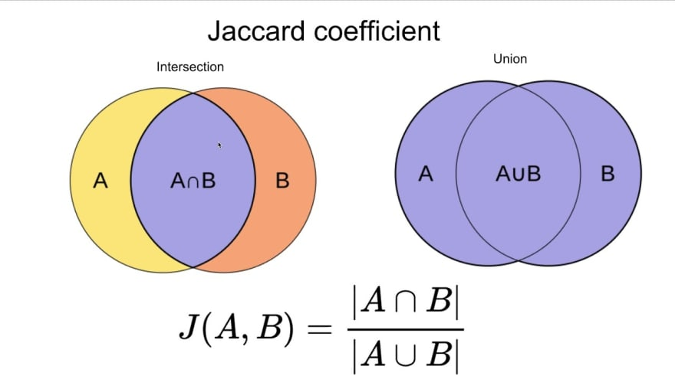
Data Processing & Feature Engineering
Feature Engineering
Feature Engineering
Binary match features:
- Sector match (json_value_sectors == sectors)
- Country match (hq_address == country)
- Scale match (scale == string_value_scale)
Similarity scores:
- Jaccard similarity for sectors, sub_sectors, industry
Features computed for each exec–opportunity pair to capture alignment in domain, geography, and company size

Slide 7
Model Training - LightGBM

Slide 8
Model Training - LightGBM
Data Prep for Training
Keep only rows with no missing values in key features and outcome
Keep only opportunities (assignment_id) with at least one positive match (outcome = 1)
Split data by assignment_id (~10% test set) to prevent leakage and preserve ranking context
Prepare LightGBM Ranker inputs:
- X_train – Feature matrix
- y_train – Binary match labels
- group_train – Number of executives evaluated per opportunity

Slide 9
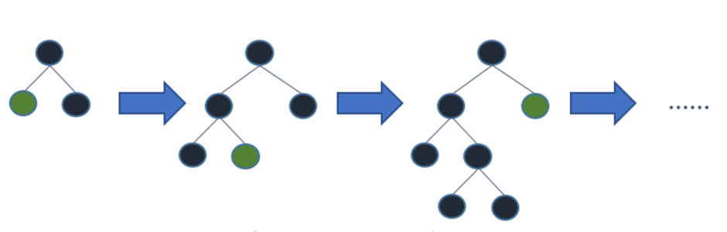
Model Training - LightGBM
LightGBM Ranker
Use LGBMRanker for Learning to Rank (LTR) tasks, based on the LambdaMART algorithm
- Optimizes ranking loss functions (e.g., NDCG)
- Learns which items (execs) should rank higher for each (assignment_id)
Key parameters:
- n_estimators=100 – Number of boosting rounds
- force_col_wise=True – Forces column-wise tree building for efficiency

Slide 10
Results and Evaluation

Slide 11
Results and Evaluation
Model Evaluation
Precision@5 measures how often the correct exec appears in the top 5 predictions for each opportunity
- Sort execs by predicted score within each assignment_id
- Select the top 5 execs
- Count as a hit if at least one has outcome = 1
Final score = mean hit rate across all opportunities
High Precision@5 → model frequently includes the correct match in its top 5 suggestions

Slide 12
Results and Evaluation
Predicting New Results
rank_execs_for_new_opp() simulates ranking execs for a new opportunity
Pairs the given opportunity with every executive
Builds the same feature columns used in training
Predicts a score for each exec–opportunity pair
Returns the top 10 ranked execs by predicted score
Mimics the real-world recommendation process for a live opportunity

Slide 13
Automating Solution

Slide 14
Automating Solution
Automation Benefits
Ensures model is always up-to-date with latest data
No manual intervention required for retraining or logging
Metrics (precision@5) automatically tracked over time for monitoring
Model artifacts versioned via GitHub Actions for reproducibility
Enables seamless transition from training → deployment

Slide 15
Automating Solution
GitHub Actions
Workflow (train_ranker.yml) runs every day at 6 AM UTC
Steps include:
- Checkout code from repository
- Install dependencies from requirements.txt
- Run train_ranker.py to retrain model and log metrics
- Upload updated model (lgbm_ranker.pkl) and precision_log.csv as artifacts
Also supports manual trigger from the Actions tab

Slide 16
Automating Solution
Further Automation Options
Apache Airflow
- Orchestrate ETL → training → deployment pipelines
- Schedule retraining and manage task dependencies
- Store DAGs in Git for version control
AWS Athena
- Query large datasets directly from S3 without ETL into PostgreSQL
- Ideal for preprocessing before training
AWS Lambda + EventBridge
- Trigger lightweight training or scoring jobs on schedule or on data updates
AWS Step Functions
- Manage multi-step workflows (data extract → train → evaluate → deploy)

Slide 17
Next Steps

Slide 18
Next Steps
Opportunities to Improve Model - Model
Better Models
- CatBoostRanker – handles categorical features natively
- XGBoostRanker – strong baseline for sparse/tabular data
- Neural ranking models – e.g., DSSM, BERT-based
- Transformer encoders – richer semantic similarity from text

Slide 19
Next Steps
Opportunities to Improve Model - Data
Enhanced Features
- Embeddings: dense vectors + cosine similarity for sector, industry, country
- Temporal: time since last match, posting recency
- Exec activity: selection count, success ratio by sector/industry
- Interaction features: sector + country + scale co-occurrence patterns
Data Enrichment
- Exec bios, past job history, skills tags
- Company descriptions, financial metrics
- Standardise sector/industry naming

Slide 20
Next Steps
Opportunities to Improve Model – Productionise and Scale
ETL Pipeline – Extract data from PostgreSQL/S3, compute features (Airflow/Lambda), store in S3/staging table
Model Training – Batch jobs on EC2/SageMaker, versioning & tracking via Mlflow
Model API – FastAPI app on ECS/Lambda exposing /predict for top 10 execs
Predictions Table – Log predictions in PostgreSQL for validation & feedback
Monitoring & Retraining – CloudWatch metrics (volume, latency, Precision@5 drift), auto-trigger retrains
Retraining Workflow – Weekly/monthly retraining, promote only if performance improves

